Slide 1
ORGANISATIONAL
BEHAVIOUR
CHAPTER-9
MOTIVATION – THEORIES AND PRINCIPLES

Slide 2
LEARNING OBJECTIVES
Motivation refers to a set of forces that energise people to behave in certain ways.
Motivation is necessary to accomplish tasks, to produce quality goods and for other related purposes.
Motivation is not an easy job. Change of workforce, change of job designs and delayering of organisations make motivation a difficult task.
Motivation theories are of two broad categories – early and contemporary theories.
Scientific management and human relations model fall under early theories category.
Contemporary theories cover content and process models.

Slide 3
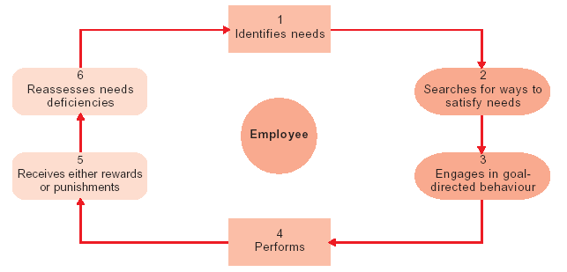
Framework of Motivation

Slide 4
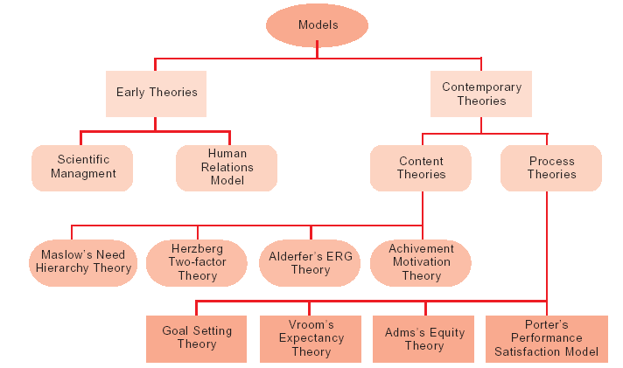
Motivational Models

Slide 5
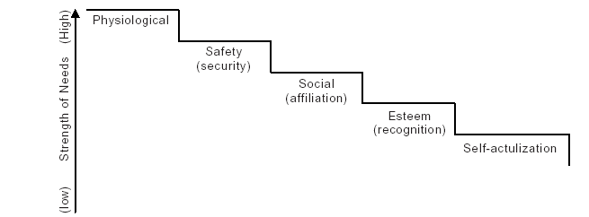
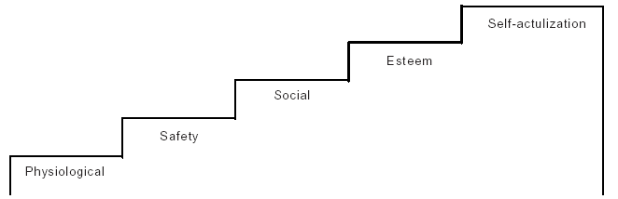
Maslow’s hierarchy of needs —
Dominance of Physiological Needs
Salf-Actulization Needs Dominant In The Need Structure

Slide 6
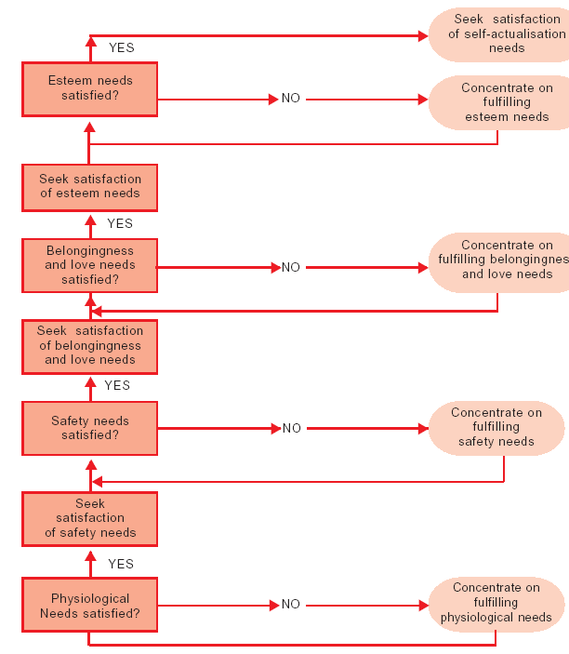
Flow Diagram of Needs Satisfaction

Slide 7
Ordering of Needs Across Countries
Country Need Priority
United States and Japan Self-actualisation, esteem, safety, physiological and social
France Self-actualisation, esteem, physiological, safety and social
Germany Self-actualisation, physiological, esteem, social and safety
India Physiological, self-actualisation, esteem, social and safety
Malawi Physiological, self-actualisation, esteem, safety and social
China Self-actualisation, safety, physiological and social

Slide 8
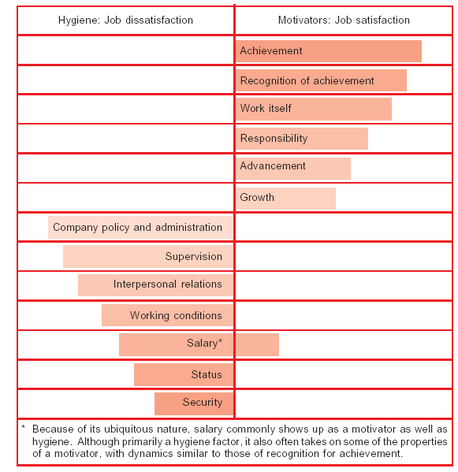
Herzberg’s Hygienes and Motivators

Slide 9
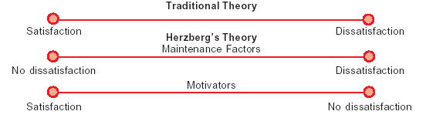
Essence of the two-factor Theory

Slide 10
Difference Between Maslow’s and
Herzberg’s Motivational Theories
Issue Maslow Herzberg
Type of theory Descriptive Prescriptive
The satisfaction Unsatisfied needs energise Needs cause performance
performance relationship behaviour, this behaviour causes
performance
Effect of need satisfaction A satisfied need is not a motivator A satisfied (hygiene) need is (except self – actualisation) not a motivator, other satisfied needs are motivators
Need order Hierarchy of needs No hierarchy
Effect of pay Pay is a motivator if it satisfies Pay is not a motivator
needs
Effect of needs All needs are motivators at various Only some needs are times motivators
View of motivation Macro view – deals with all aspects Micro view – deals primarily of existence with work related motivation
Worker level Relevant for all workers Probably more relevant to white – collar and
professional workers

Slide 11
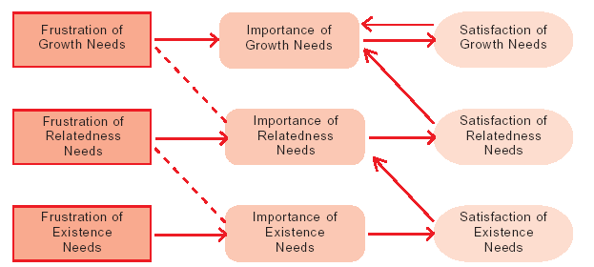
Two Key Components of ERG Theory; Satisfaction— Progression and Frustration-Regrssion

Slide 12
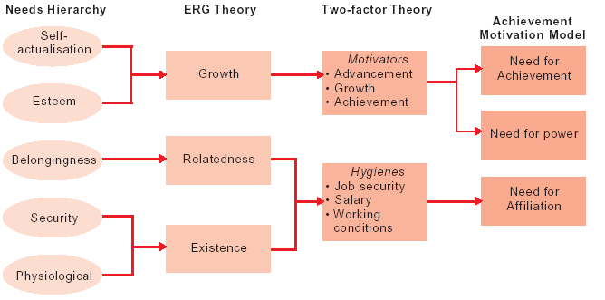
Matching Content Theories

Slide 13
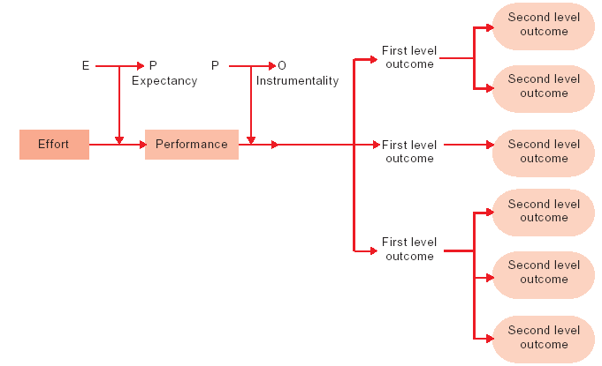
Expectancy Theory

Slide 14
APPLICATION OF EXPECTANCY THEORY
Variable Objective Applications
E P Expectancies To increase the belief that • Select people with required skills and knowledge.
employees are capable • Provide required training and clarify job requirements.
of performing the job • Provide sufficient time and resources.
successfully • Assign simpler or fewer tasks until employees can master them.
• Provide examples of similar employees who have successfully performed the tasks.
• Provide counseling and coaching to employees who lack self-confidence.
P O instrumentalities To increase the belief that • Measure job performance accurately.
good performance will • Clearly explain the outcomes that will result from
result in valued outcomes successful performance.
• Describe how the employee’s rewards were based on past performances.
Valences of outcomes To increase the expected • Distribute rewards that employees value.
value of outcomes resulting • Individualise rewards.
from desired performance • Minimise the presence of counter-valent outcomes.

Slide 15
EXAMPLES OF INPUTS AND OUTCOMES IN ORGANISATIONS
Inputs Outcomes
Age Challenging job assignment
Attendance Fringe benefits
Interpersonal skills Job perquisites (parking space or office location)
Communication skills Job security
Job effort (long hours) Monotony
Level of education Promotion
Past experience Recognition
Performance Responsibility
Personal appearance Salary
Seniority Seniority benefits
Social status Status symbols
Technical skills Working conditions

Slide 16
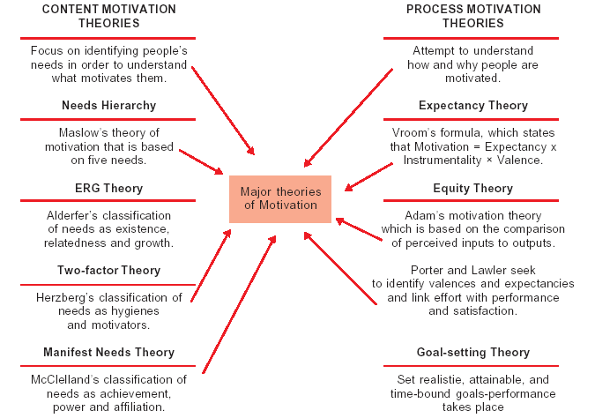
Motivational Theories

Slide 17
Key Terms
Motivation
Process theories
Relevant other
Equity
Need for affiliation (nAff)
Expectancy
Instrumentality
Need for power (nPow)
Content theories
Need hierarchy
Equity dynamic
Existential philosophy
Need for achievement (nAch)
Valence
Rabble hypothesis

